Slide 1

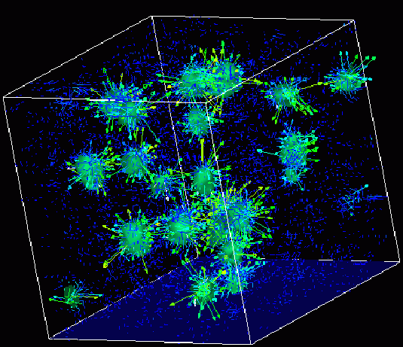

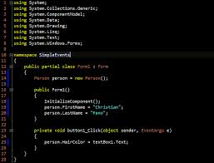
Advanced
Scientific Computing
(SciComp 201)
Session 05
Linear Algebra, Simultaneous Equations

Slide 2
Seminar Goals
Create a custom C++ header file and add it to the solution
Learn how to declare and define a 2D array in C++ declared on the stack, not on the heap
Implement Cramer’s rule to solve a system of linear solutions (3 equations and 3 unknowns)
Review how to declare and define a 2D matrix of size[3,3]
Calculate the determinant of a 3x3 matrix
Learn how to overlay the columns of one vector on top of another
Implement a function to perform matrix multiplication

Slide 3
Creating a Custom Header (.h) File
Recall header files (.h) store function prototypes which are just forward declarations with no defining statements (no actual body scopes having curly braces)
Usually the header filename prefix is the same as that for the .CPP source file which actually defines the functions
You then #include “yourheader.h” in any CPP file that references any of those functions
Prototypes inform the compiler of the name of the function, the number & types of each parameter, and the return type
Taken together this information is called the function signature
You can include parameter (variable) names to provide users of your API with Visual Studio Intellisense aids

Slide 4
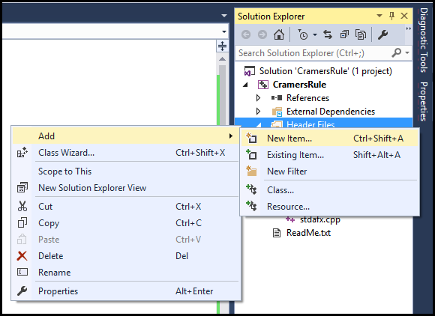
Creating a Custom Header (.h) File
Right click on “Header Files” then select “Add New Item…

Slide 5
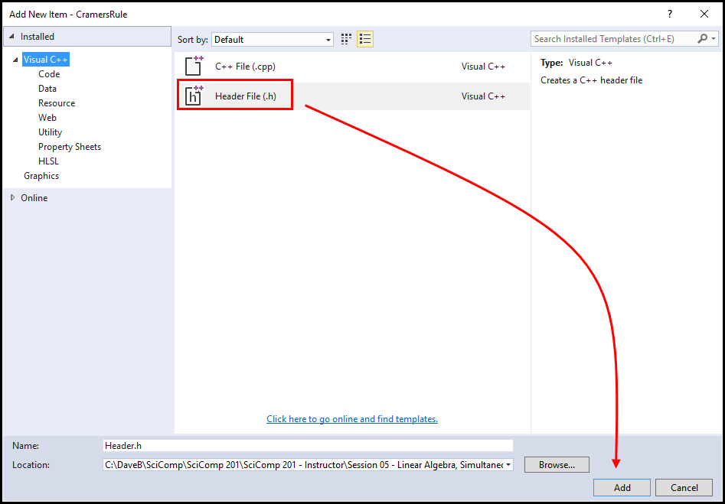
Creating a Custom Header (.h) File

Slide 6
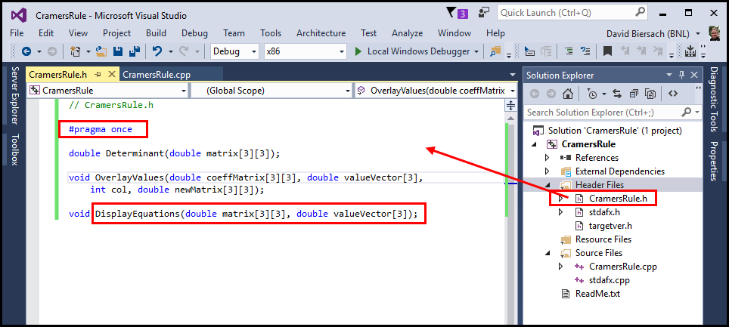
Creating a Custom Header (.h) File

Slide 7
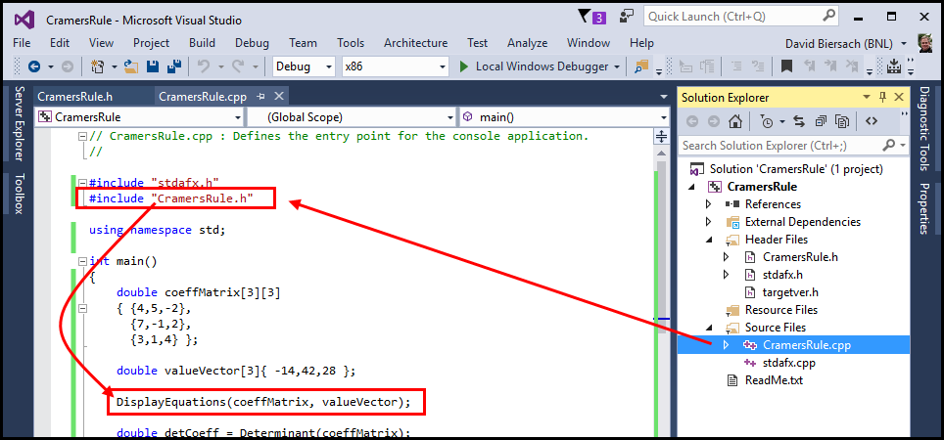
Creating a Custom Header (.h) File

Slide 8
Matrices
A “matrix” in C++ is called an array
An array can hold any number of elements (in each dimension) but all elements must be of the same data type, such as int or double
Matrix elements are accessed by their index numbers, which starts at zero and correspond to each dimension
Array sizes
In mathematics, a matrix size is written as (Rows x Columns)
In C++ an array size is written using commas instead of multiplication crosses, and using square brackets instead of parenthesis: [Rows, Columns]
A C++ array [5,7] has 5 rows and 7 columns

Slide 9
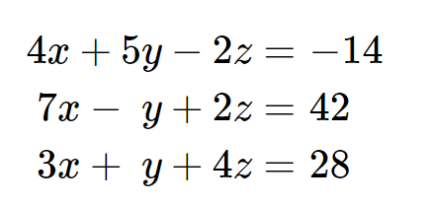
Goal: Solve a System of Linear Equations
Three Equations and Three Unknowns

Slide 10
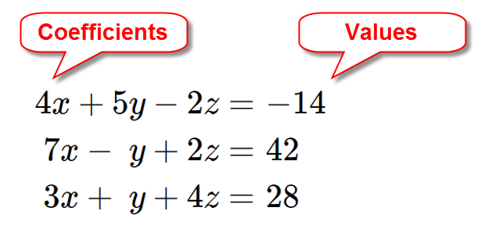
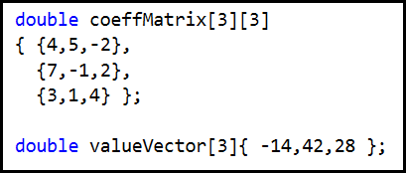
Create a Coefficient Matrix & Value Vector

Slide 11
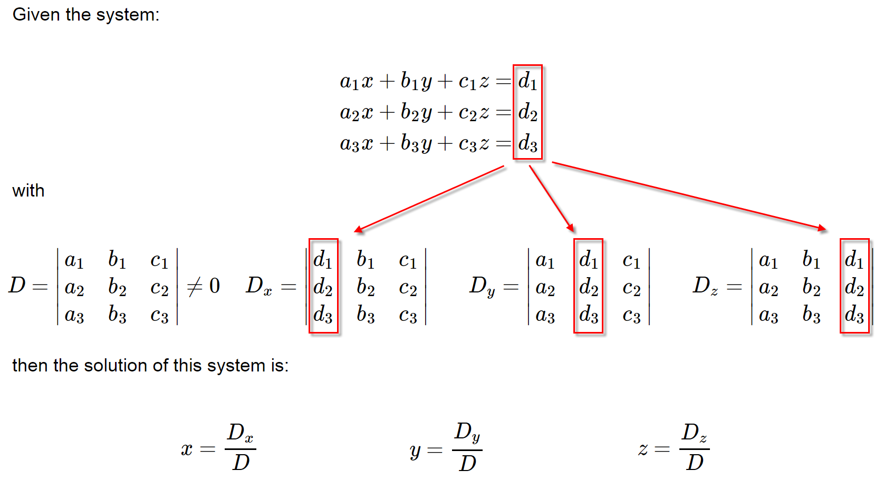
Cramer’s Rule

Slide 12
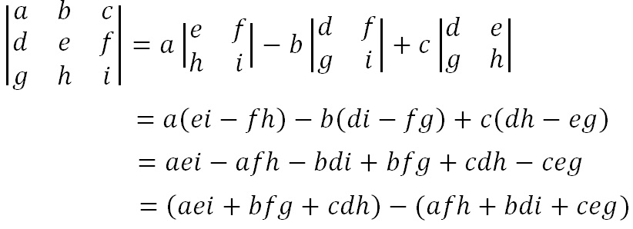
Cramer’s Rule
Calculating the Determinant of a 3 x 3 Matrix

Slide 13
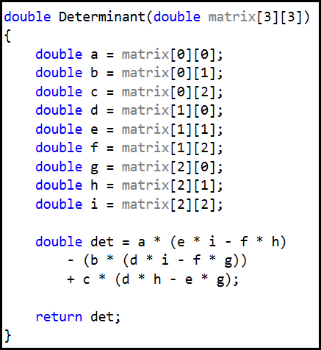
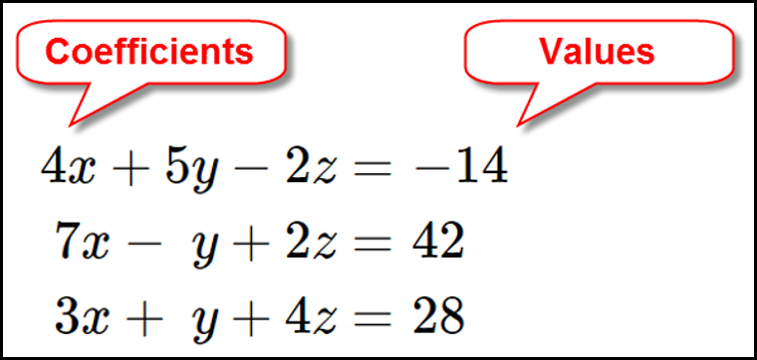
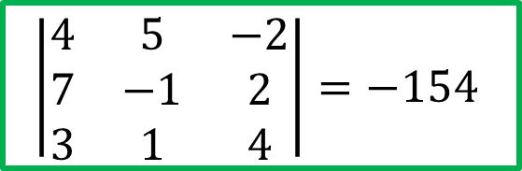
Cramer’s Rule
Calculating the Determinant of a 3 x 3 Matrix
$$\left|\begin{matrix}4 & 5 & −2 \\ 7 & −1 & 2 \\ 3 & 1 & 4\end{matrix}\right|=−154$$
Coefficient Matrix

Slide 14
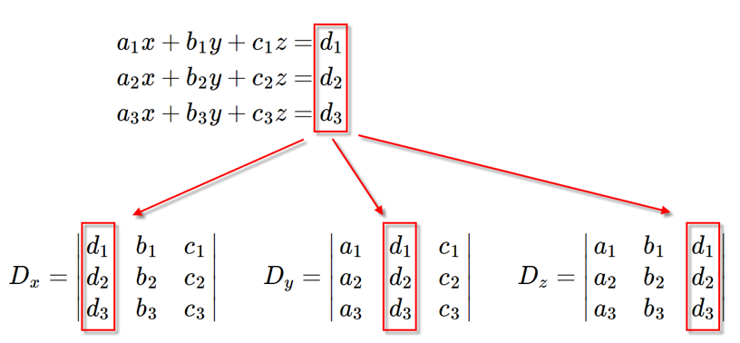
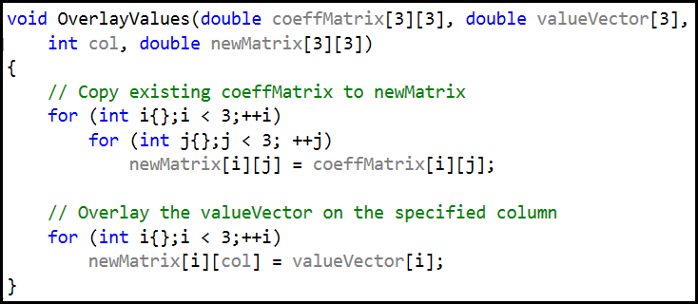
Cramer’s Rule
Overlay the values onto the coeffMatrix

Slide 15
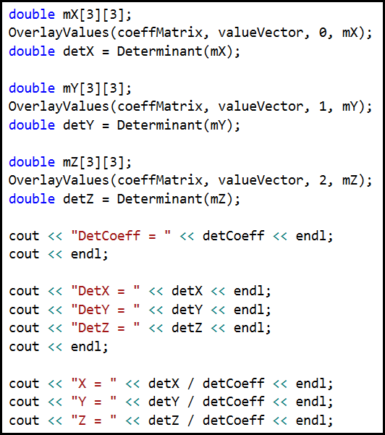
Cramer’s Rule
Create new matrices mX, mY, mZ

Slide 16
Lab 1 – Cramer’s Rule
Develop a console mode C++ application that uses Cramer’s Rule to solve a system of three linear equations with three unknowns
The code encodes the system of equations as a 2D coefficient matrix and value vector (a 1D array)
The code already handles linearly dependent systems
The code will display the equations using standard algebraic formatting rules (aka “pretty print”)
No coefficients of 1, such as 1x + 5y + 32z = 49
No plus signed followed by a negative sign, such as 2x + -5y + 9 = -13
Don’t display an unknown if that term’s coefficient is 0

Slide 17
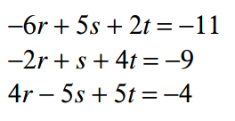
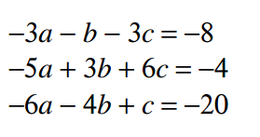
Lab 1 – Cramer’s Rule
Implement the Determinant() & OverlayValues() functions in “CramersRule.cpp”
Update the main() function to solve these two systems of linear equations:

Slide 18
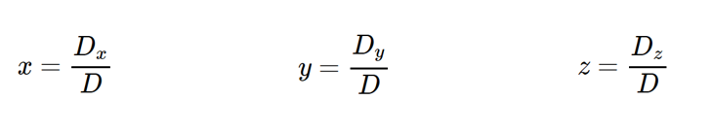
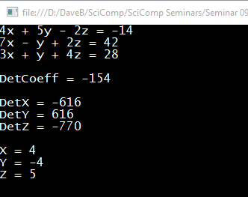
Lab 1 - Cramer’s Rule
What does it mean if D = 0?

Slide 19
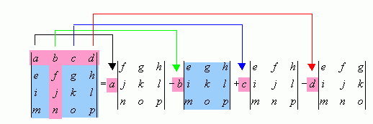
Cramer’s Rule
Calculating the Determinant of a 4 x 4 Matrix

Slide 20
Matrix Multiplication
When rendering computer graphics, we often need to find the product of two matrices, e.g.
$$\left(\begin{matrix}4 & 5 & 8 \\ 1 & 9 & 7\end{matrix}\right)⋅\left(\begin{matrix}2 & 4 \\ 6 & 1 \\ 5 & 9\end{matrix}\right)= ?$$
There is a standard algorithm to do this multiplication
It involves multiplying each element in the rows of first matrix by each element in the columns of the second matrix

Slide 21
Matrix Multiplication
In order to multiply two matrices together, the number of columns in matrix A must equal the number of rows in matrix B (Cols A = Rows B)
The resulting matrix will have as many rows as there were rows in matrix A, and as many columns as there were columns in matrix B (Rows A x Cols B)

Slide 22
Matrix Multiplication
Example
Matrix A has dimension (2 x 3) = 2 rows, 3 columns
Matrix B has dimension (3 x 2) = 3 rows, 2 columns
$$\left(\begin{matrix}4 & 5 & 8 \\ 1 & 9 & 7\end{matrix}\right)⋅\left(\begin{matrix}2 & 4 \\ 6 & 1 \\ 5 & 9\end{matrix}\right)= ?$$
The inner values must match!
(2 x 3) • (3 x 2)
The outer values will be
the dimension of the final
matrix product!

Slide 23
Matrix Multiplication
Matrix multiplication is not commutative!
If we multiple A x B we will get a different matrix than if we multiply B x A
(3 x 2) • (2 x 3) = result is a (3 x 3) matrix
(2 x 3) • (3 x 2) = result is a (2 x 2) matrix
Welcome to the world of non-commutative algebra
This is very strange – it catches even great physicists by surprise!
This asymmetry is the foundation of the matrix formulation of quantum mechanics

Slide 24
Matrix Multiplication
The algorithm is simple but tedious for A x B = C
Sum the product of every element in each row of matrix A and the corresponding element in each column of matrix B
That sum becomes just one element in new matrix C
Continue this process for all rows in matrix A
Every row in A gets multiplied by every column in B
The resulting matrix will have dimensions (Rows A x Cols B)

Slide 25
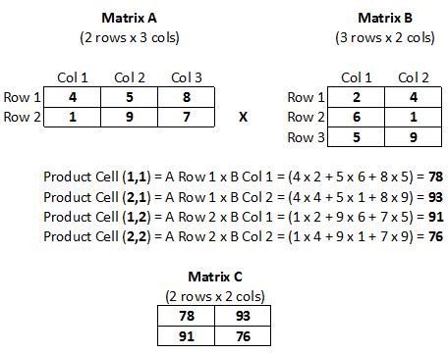
Matrix Multiplication

Slide 26
Matrix Multiplication

Slide 27
Matrix Multiplication

Slide 28
Matrix Multiplication

Slide 29
Matrix Multiplication

Slide 30
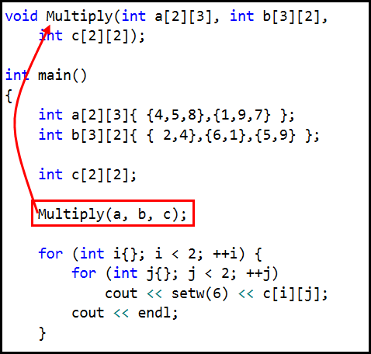
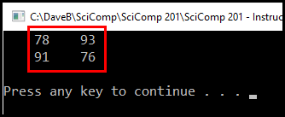
Lab 2 – Matrix Multiplication
Implement the Multiply() function that multiples a (2 x 3) integer matrix by a (3 x 2) integer matrix
The code will display the product matrix in row, col format

Slide 31
Now you know…
Cramer’s Rule is a step-by-step algorithmic way to solve systems of linear equations without the tedious algebra of back substitution – it uses determinants
Matrix dimensions are written Row x Column
To multiply two matrices, the # of columns in the first matrix must match the # of rows in the second matrix
The product matrix will have the same # of rows as the first matrix, and the same # of columns as the second matrix
Matrix multiplication is the sum of the element by element products of the rows in the first matrix and the columns in the second matrix

